Slide 1



Internet des objets et Contiki
Jeudis du Libre, UMons
Sébastien DAWANS
Laurent DERU
17/10/2013
© CETIC – www.cetic.be

Slide 2

Embedded &
Communication Systems
Software & System Engineering
Software & Services Technologies

Slide 3

Menu du jour
Définition de l’Internet des Objets
Standards de l’IoT
Contiki
Activités du CETIC

Slide 4
Internet of Things
1999
200x
201x
RFID
M2M
Smartphones,
RFID, Cloud…
Junction of the physical and digital worlds

Slide 5
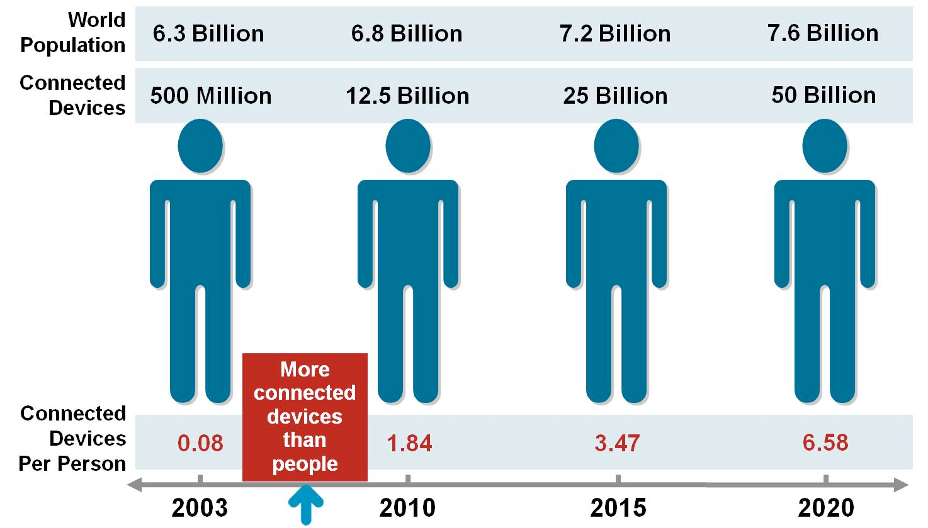
Cisco’s Vision
Birth of
the IoT
Source: Cisco IBSG, April 2011

Slide 6
« the * syndrome »
Any*
Smart*
*aware
AnyOne
AnyThing
AnyWhere
AnyBusiness
AnyNetwork
AnyContext
SmartHome
SmartBuilding
SmartEnergy
SmartGrid
SmartCity
SmartFactory
SmartAgriculture
Context-Aware
Self-Aware
Process-Aware
… ?

Slide 7
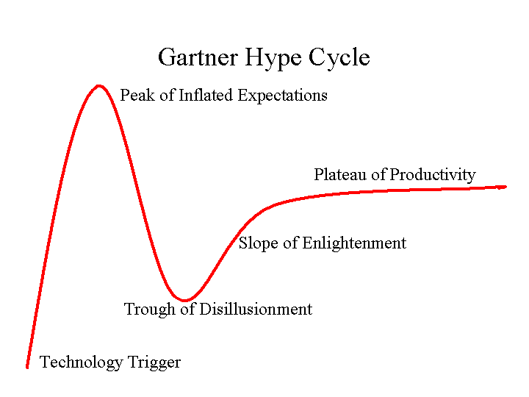

Slide 8
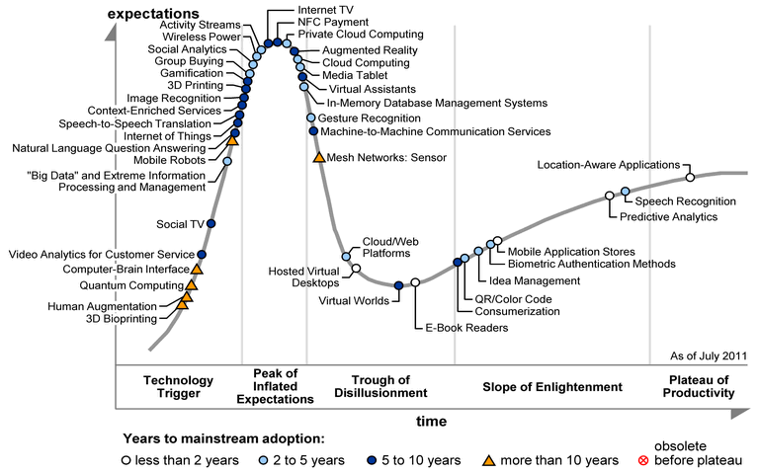
Gartner, 2011

Slide 9
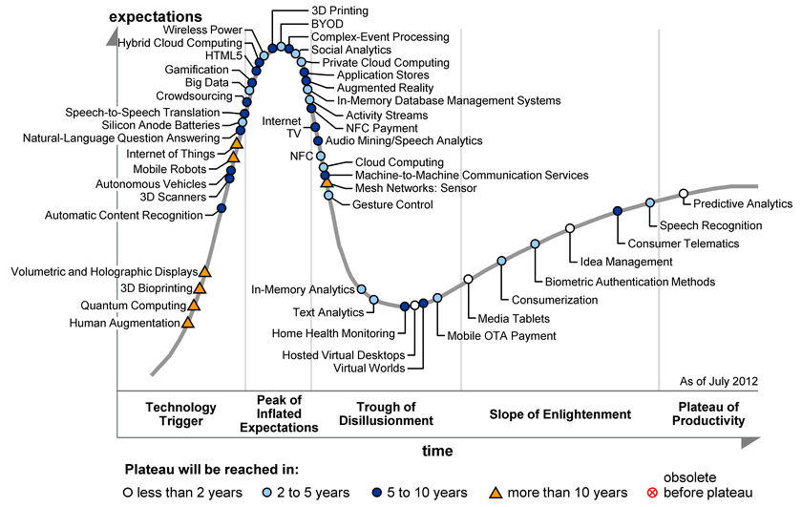
Gartner, 2012

Slide 10
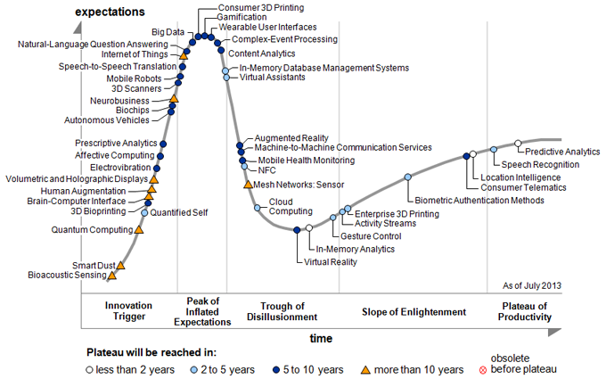
Gartner, 2013

Slide 11
IMHO… IoT is
Interacting with the
Physical World
using Software
and Networking

Slide 12
Internet of Things
1: IPv6
Open Standard
Widespread
Scalable
Auto-configuration
Simple

Slide 13

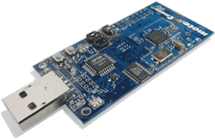
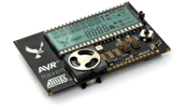
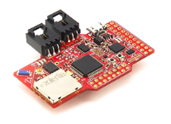
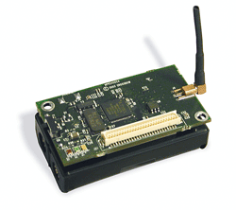
Contiki: OS for the IoT
Runs on small devices, sensor networks, etc
Low power, low memory
Certified IPv6 stack
Supports a variety of hardware
Open-source, contributors from
SICS, Cisco, Redwire LLC, and many others

Slide 14
Internet of Things
2: Cloud
Cloud-centric IoT
Objects as simple as possible
Intelligence in the Cloud
Standard interfaces
No complex application logic

Slide 15



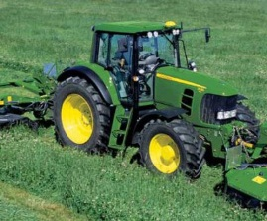
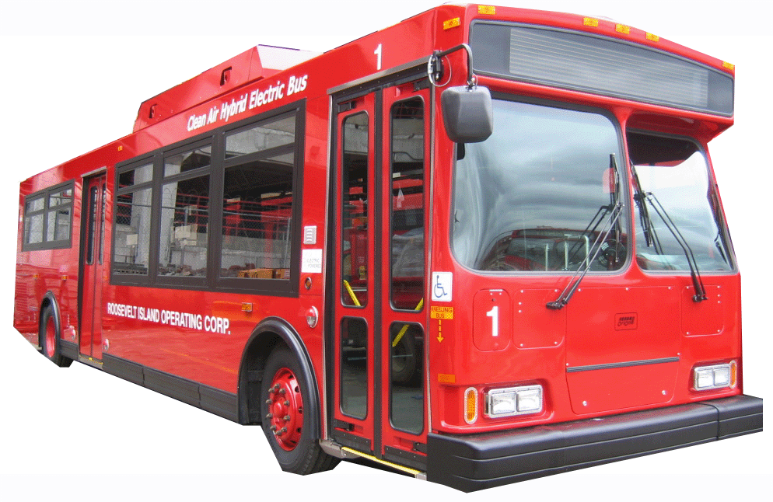

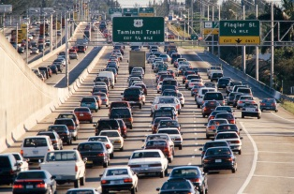
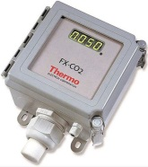
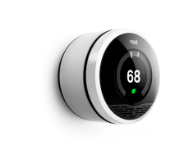


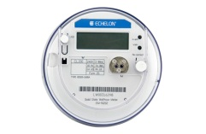

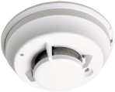
Cloud-Centric IoT
app
app
app
app
app

Slide 16
Internet of Things
3: Semantics
Object identity
Virtual/Physical duality
Service & Role discovery
CoAP

Slide 17
IoT will be based on semantics
GET <resource>
<of what?>
reply
app
app
POST <data>
<to what?>
app
PUSH
<notification>

Slide 18
Some
Applications

Slide 19
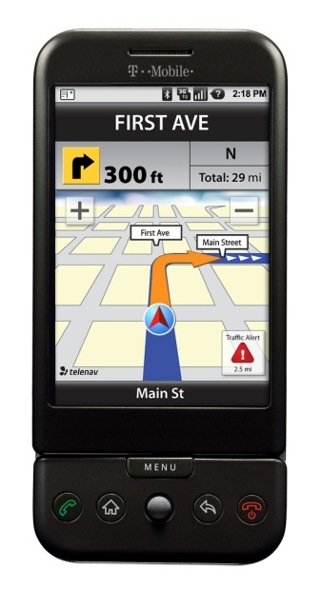

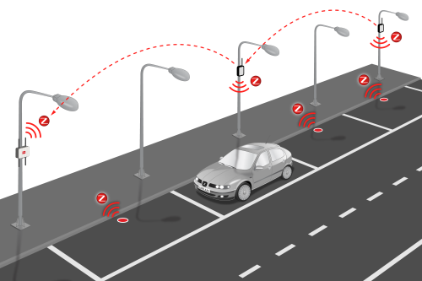
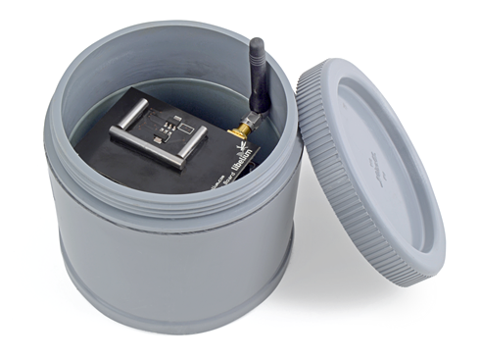
Smart Parking
Cloud App:
APIs
Path Calculation
WSN Mngt
Billing
Smart
Park
Keep objects and clients simple
http://www.libelium.com/smart_parking/

Slide 20


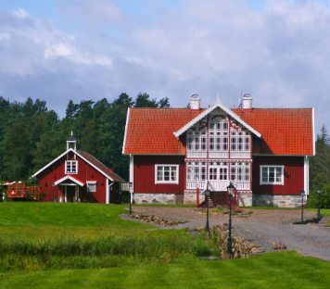
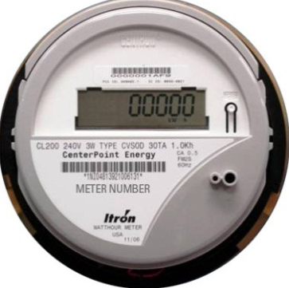
Smart Grid
Clever electricity management
Generation, distribution, consumption
Green, efficient, secured
Dynamic pricing
Anticipation of needs

Slide 21

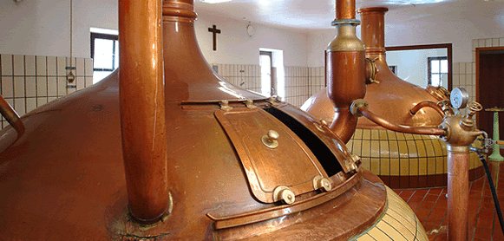
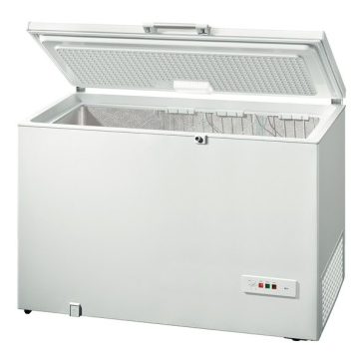

Smart Grid in a Zoning

Slide 22
Smart Grid in a Zoning
= €

Slide 23


Smart Grid in a Zoning
= €

Slide 24
Smart Grid in a Zoning
= €
Let’s optimize locally
Self-sufficiency

Slide 25
Smart Grid in a Zoning
= €
Zoning Optimizer
control
control
share energy
-18°C

Slide 26
Smart Grid in a Zoning
= €
Zoning Optimizer
control
control
-24°C
store energy

Slide 27
Smart Grid in a Zoning
Inputs:
Production forecast
Consumption forecast
Urgency of tasks
Optimization Criteria
Outputs:
Schedule proposition
Announce supply/demand
Global optimization
Instead of local optim.
Calculate « cost » of kWh
Zoning Optimizer

Slide 28

Is one vision of the IoT
Inspired by the World Wide Web
Objects connect through the Web
Objects use Web protocols (& technologies & tools)
Adoption of the RESTful architecture

Slide 29
Designing The
IoT

Slide 30
Open Standards
What we already had
IPv4/6
A massive internet
Isolated Wireless Sensor Networks (WSN)

Slide 31

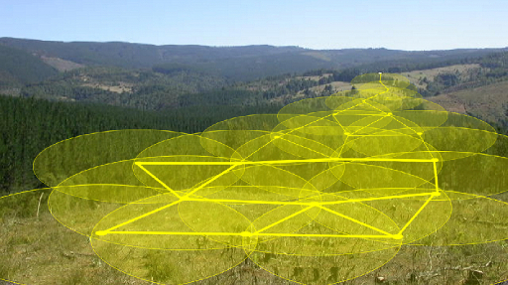
Wireless Sensor Networks (WSN)
Traditionally:
Multihop
Autonomous
Low-Power
Low-Throughput
No Maintenance
Fault-tolerant
Data-collect
Gateways

Slide 32
Wireless Sensor Networks (WSN)
Common
Destination
Multihop
Data Collection

Slide 33
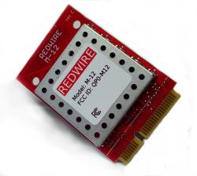
Typical WSN Hardware
µC
8-16kB RAM, 48-128kB Flash
A few MHz
802.15.4 radio
a few sensors
GPIO
Some external flash (1-8 Mbit)
Batteries
Cheap

Slide 34
Wireless Sensor Networks (WSN)
Now becoming a subset of IoT
IoT
IPv6
GET
Bidirectionnal
Data Patterns
WSN
IPv6

Slide 35
Wireless Sensor Networks (WSN)
Now becoming a subset of IoT
IoT
IPv6
response
Bidirectionnal
Data Patterns
WSN
IPv6

Slide 36
Wireless Sensor Networks (WSN)
Now becoming a subset of IoT
IoT
IPv6
response
Bidirectionnal
Data Patterns
WSN
IPv6
Full end-to-end IPv6

Slide 37
Open Standards
What we already had
IPv4/6
A massive internet
Isolated Wireless Sensor Networks (WSN)
What was added (IETF)
6LoWPAN: IPv6 for 802.15.4 WSNs
RPL: Routing protocol for 6LoWPAN
CoAP: RESTful protocol for constrained applications

Slide 38

IPv6: the Narrow Waist
HTTP
CoAP
NDP
RPL
IPv6
6LoWPAN
802.3x
802.15.4

Slide 39
IPv6: the Narrow Waist
HTTP
CoAP
NDP
RPL
IPv6
6LoWPAN
802.3x
802.15.4

Slide 40
6LoWPAN: IPv6 for 802.15.4
Maximum Transmission Unit (MTU)
Minimum 1280 bytes in IPv6
But Maximum 127 bytes MAC frames in 802.15.4
127 B
~25 B
40 B
8 B
54 B
56% overhead
44% data
MAC 802.15.4
IPv6
UDP
DATA

Slide 41
6LoWPAN: IPv6 for 802.15.4
Maximum Transmission Unit (MTU)
Minimum 1280 bytes in IPv6
But Maximum 127 bytes MAC frames in 802.15.4
6LoWPAN: Reduce the IPv6 packet size
Header Compression
Fragmentation
127 B
~25 B
40 B
8 B
54 B
56% overhead
44% data
MAC 802.15.4
IPv6
UDP
DATA

Slide 42
6LoWPAN Header Compression
Goal: Compress as much of the IPv6 Header
0
7
15
23
31
Version
TC
Flow Label
8 B
Payload Length
Next Header
Hop Limit
Source Address (128 bits)
16 B
Destination Address (128 bits)
16 B

Slide 43
6LoWPAN Header Compression
Goal: Compress as much of the IPv6 Header
Insert 6LoWPAN Header with compression information
3 mechanisms
Make assumptions
Infer Information from 802.15.4 Header
Compress possible values to a subset
MAC 802.15.4
6LoWPAN
IPv6
UDP
DATA
« dispatch »

Slide 44
6LoWPAN Header Compression
0 1 2 3 4 5 6 7 8 9 10 11 12 13 14 15
dispatch
0 1 1
T F
NH
HLIM
CID
SAC
DAM
M
DAC
DAM
0
7
15
23
31
Always 6!
Version
TC
Flow Label
8 B
Payload Length
Next Header
Hop Limit
Source Address (128 bits)
16 B
Destination Address (128 bits)
16 B

Slide 45
6LoWPAN Header Compression
0 1 2 3 4 5 6 7 8 9 10 11 12 13 14 15
dispatch
0 1 1
T F
NH
HLIM
CID
SAC
DAM
M
DAC
DAM
4 possible states of TF: carried inline or not, etc
→ Best case (11): assume all 0, save 3 bytes
0
7
Usually 0
15
23
31
Always 6!
Version
TC
Flow Label
8 B
Payload Length
Next Header
Hop Limit
Source Address (128 bits)
16 B
Destination Address (128 bits)
16 B

Slide 46
6LoWPAN Header Compression
0 1 2 3 4 5 6 7 8 9 10 11 12 13 14 15
dispatch
0 1 1
T F
NH
HLIM
CID
SAC
DAM
M
DAC
DAM
0
7
Usually 0
15
23
31
Always 6!
Version
TC
Flow Label
8 B
Inferred
Payload Length
Next Header
Hop Limit
Source Address (128 bits)
16 B
Destination Address (128 bits)
16 B

Slide 47
6LoWPAN Header Compression
0 1 2 3 4 5 6 7 8 9 10 11 12 13 14 15
dispatch
0 1 1
T F
NH
HLIM
CID
SAC
DAM
M
DAC
DAM
0: inline = 1 byte in IPv6 + next header inline
1: compressed = 1 byte defining NH + compression of next header
0
7
Usually 0
15
23
31
Always 6!
Version
TC
Flow Label
8 B
Inferred
Payload Length
Next Header
Hop Limit
Source Address (128 bits)
subset
16 B
Destination Address (128 bits)
16 B

Slide 48
6LoWPAN Header Compression
0 1 2 3 4 5 6 7 8 9 10 11 12 13 14 15
dispatch
0 1 1
T F
NH
HLIM
CID
SAC
DAM
M
DAC
DAM
Inline; 1, 64, 255
0
7
Usually 0
15
23
31
Always 6!
Version
TC
Flow Label
8 B
Inferred
Payload Length
Next Header
Hop Limit
subset
Source Address (128 bits)
subset
16 B
Destination Address (128 bits)
16 B

Slide 49
6LoWPAN Header Compression
0 1 2 3 4 5 6 7 8 9 10 11 12 13 14 15
dispatch
0 1 1
T F
NH
HLIM
CID
SAC
DAM
M
DAC
DAM
Inline; 1, 64, 255
We need it for multihop
0
7
Usually 0
15
23
31
Always 6!
Version
TC
Flow Label
8 B
Inferred
Payload Length
Next Header
Hop Limit
subset
Source Address (128 bits)
subset
16 B
Destination Address (128 bits)
16 B

Slide 50
6LoWPAN Header Compression
0 1 2 3 4 5 6 7 8 9 10 11 12 13 14 15
dispatch
0 1 1
T F
NH
HLIM
CID
SAC
DAM
M
DAC
DAM
Most common: infer 64-bit prefix from link-local prefix
CID: stateful compression (more gain)
0
7
Usually 0
15
23
31
Always 6!
Version
TC
Flow Label
8 B
Inferred
Payload Length
Next Header
Hop Limit
subset
Source Address (128 bits)
subset
16 B
Destination Address (128 bits)
16 B

Slide 51
6LoWPAN Header Compression
Result:
IPv6 Header decreases from 40 bytes to about 7
80-90 bytes for data
Fragmentation takes care of larger packets
Fragmentation header with fragment ##

Slide 52
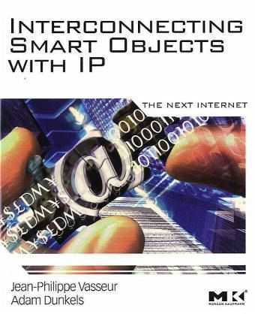
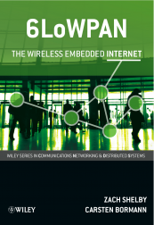
More on 6LoWPAN
6LoWPAN: The Wireless Embedded Internet
by Zach Shelby (Sensinode, ARM)
and Carsten Bormann (Universität Bremen)
by Adam Dunkels (SICS, Thingsquare)
and Jean-Philippe Vasseur (Cisco)
Great Wikipedia Page in FR! (forget the EN one)
http://fr.wikipedia.org/wiki/6LoWPAN

Slide 53
IPv6: the Narrow Waist
HTTP
CoAP
NDP
RPL
IPv6
6LoWPAN
802.3x
802.15.4

Slide 54
RPL: Routing Protocol for 6LoWPAN
Facts
Low Power & Lossy Networks (LLN)
Links are highly dynamic
Must support bidirectional traffic
Optimized for collect (MP2P)
Basic support of root → node (P2MP)
Basic support of node → node (P2P)
Energy / availability / latency compromise
Must be flexible
Scalable (destinations, density)

Slide 55
RPL
DODAG: inspired by data-collect protocols
1
2
4
6
3
5
7

Slide 56
RPL
DODAG: inspired by data-collect protocols
1
Periodic Broadcasts (DIO)
2
4
6
3
5
7

Slide 57
RPL
DODAG: inspired by data-collect protocols
1
Periodic Broadcasts (DIO)
Uproutes
2
4
6
3
5
7

Slide 58
RPL
DODAG: inspired by data-collect protocols
1
Periodic Broadcasts (DIO)
Uproutes
2
4
6
3
5
7

Slide 59
RPL
DODAG: inspired by data-collect protocols
1
Periodic Broadcasts (DIO)
Uproutes
2
4
6
3
5
7

Slide 60
RPL
DODAG: inspired by data-collect protocols
1
Periodic Broadcasts (DIO)
Uproutes
Keep broadcasting to
update ranks (with backoff)
2
4
6
3
5
7

Slide 61
RPL
Distance-vector routing protocol
Link
Metric
1
Periodic Broadcasts (DIO)
Uproutes
Keep broadcasting to
update ranks (with backoff)
Rank = cost to sink
Node
Metric
2
4
6
Link
Metric
3
5
7
Rank 3, through 3→2→1 = Link 3→2 + Rank 2

Slide 62
RPL
ETX: Estimated Transmission Count (Link metric)
→ Cumulative TX to reach sink, through a parent
1
Periodic Broadcasts (DIO)
Uproutes
Keep broadcasting to
update ranks (with backoff)
Rank = cost to sink
Metric example: ETX, based
on dynamic measurements
Datapath Validation
ETX 2-1
2
4
6
ETX 3-2
3
5
7
Rank 3, through 3→2→1 = Link 3→2 + Rank 2

Slide 63
RPL
Remember, IoT → Down Traffic
Down Traffic needs routing tables
PING 3
?
1
2
4
6
3
5
7

Slide 64
RPL
Remember, IoT → Down Traffic
Down Traffic needs routing tables
1
Destination Advertisement
(DAO)
DAO: 3,2
2
4
6
DAO: 3
3
5
7

Slide 65
RPL
Remember, IoT → Down Traffic
Down Traffic needs routing tables
Dest | NH
2 | 2
3 | 2
1
Destination Advertisement
(DAO)
Dest | NH
3 | 3
2
4
6
3
5
7

Slide 66
RPL
Remember, IoT → Down Traffic
Down Traffic needs routing tables
Dest | NH
2 | 2
3 | 2
PING 3
1
Destination Advertisement
(DAO)
Dest | NH
3 | 3
2
4
6
3
5
7

Slide 67
RPL
Remember, IoT → Down Traffic
Down Traffic needs routing tables
Dest | NH
2 | 2
3 | 2
PING 3
1
Destination Advertisement
(DAO)
PING 3
Dest | NH
3 | 3
2
4
6
3
5
7

Slide 68
RPL
Remember, IoT → Down Traffic
Down Traffic needs routing tables
Dest | NH
2 | 2
3 | 2
PING 3
1
Destination Advertisement
(DAO)
PING 3
Dest | NH
3 | 3
2
4
6
PING 3
3
5
7

Slide 69
RPL
P2P traffic is possible
1
Dest | NH
3 | 3
2
4
6
3
5
7

Slide 70
RPL
Dest | NH
2 | 2
3 | 2
7 | 6
…
5 | 2
P2P traffic is possible
1
Dest | NH
3 | 3
Dest | NH
7 | 7
2
4
6
3
5
7

Slide 71
IPv6: the Narrow Waist
HTTP
CoAP
NDP
RPL
IPv6
6LoWPAN
802.3x
802.15.4

Slide 72
CoAP
A RESTful protocol
GET /temp
client
server
200 OK
app/text
23°C
client
server

Slide 73
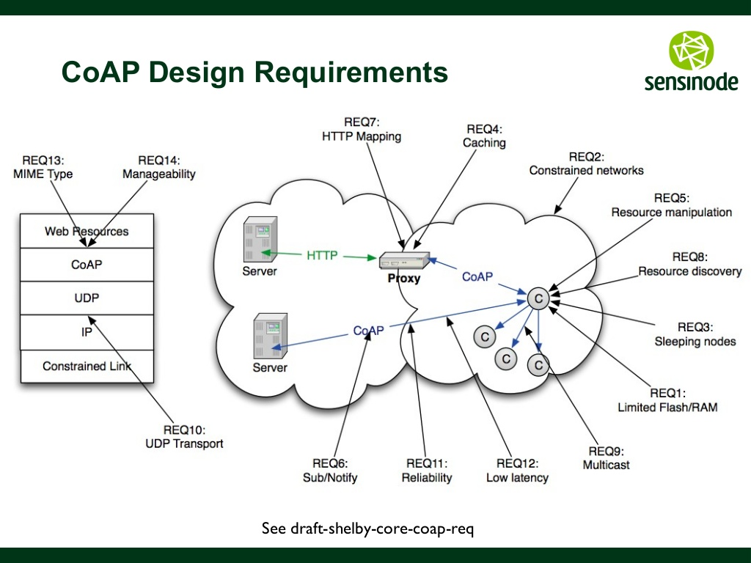
CoAP
http://fr.slideshare.net/zdshelby/coap-tutorial

Slide 74
CoAP
CoAP: Time for a Demo
http://fr.slideshare.net/zdshelby/coap-tutorial

Slide 75
Putting it all together
HTTP
CoAP
NDP
RPL
IPv6
6LoWPAN
802.3x
802.15.4
with
Contiki
www.contiki-os.org
www.github.com/contiki-os/contiki

Slide 76

Contiki
uIP:
TCP/IP stack for 8 & 16-bit µC
Single buffer
Standalone until v0.9
Tiny
Code size < 5k
RAM ~1k (= mostly the packet buffer)
2001
uIP

Slide 77
Contiki
2001
2003-2004
uIP
Contiki,
Protothreads

Slide 78
Protothreads
Non pre-emptive systems
Event-Driven model (TinyOS)
+ Good for interfacing with hardware & reactive processing
Difficult to sequence high-level operations, needs complex state machines
Lots of functions → overhead
Protothreads (Contiki)
+ Linear code execution for event-driven systems
+ Low overhead (stackless threads)

Slide 79
Protothreads: wait for events
int a_protothread(struct pt *pt) {
PT_BEGIN(pt);
PT_WAIT_UNTIL(pt, condition1);
if(something) {
PT_WAIT_UNTIL(pt, condition2);
}
PT_END(pt);
}
/* … */
/* … */
/* … */
/* … */
http://dunkels.com/adam/dunkels06protothreads.ppt ‎

Slide 80
Protothreads: yielding
int a_protothread(struct pt *pt) {
PT_BEGIN(pt);
PT_WAIT_UNTIL(pt, condition1);
if(something) {
PT_WAIT_UNTIL(pt, condition2);
}
PT_END(pt);
}
int a_protothread(struct pt *pt) {
PT_BEGIN(pt);
PT_WAIT_UNTIL(pt, condition1);
if(something) {
PT_PAUSE(pt);
}
PT_END(pt);
}
int a_protothread(struct pt *pt) {
PT_BEGIN(pt);
PT_WAIT_UNTIL(pt, condition1);
if(something) {
PT_WAIT_UNTIL(pt, condition2);
}
PT_END(pt);
}
int a_protothread(struct pt *pt) {
PT_BEGIN(pt);
PT_WAIT_UNTIL(pt, condition1);
if(something) {
PT_WAIT_UNTIL(pt, condition2);
}
PT_END(pt);
}
SCHEDULER

Slide 81
Protothreads
Bottom line
=
Let’s you program
sequentially with
multi-threading in C
On

Slide 82
Contiki
2001
2003-2004
2007
uIP
Contiki,
Protothreads
COOJA,
Power Profiling

Slide 83
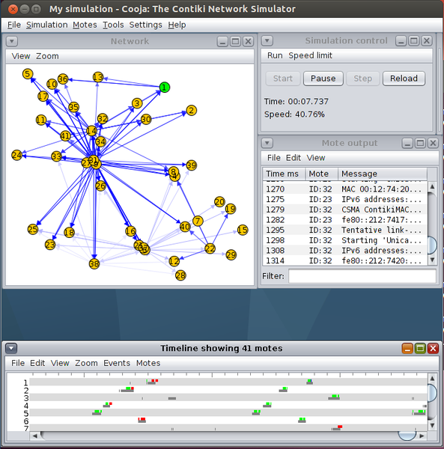
COOJA
Run bytecode on
emulated HW
Time-accurate
WSN simulation

Slide 84

Contiki
2001
2003-2004
2007
uIP
Contiki,
Protothreads
COOJA,
Power Profiling
2008
SICSLoWPAN

Slide 85
Contiki
2001
2003-2004
2007
uIP
Contiki,
Protothreads
COOJA,
Power Profiling
2008
2009-2010
SICSLoWPAN
Many more
Platforms

Slide 86
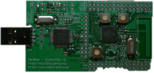

Multi-Platform Build System
User App
Platform
Contiki
App-specific conf
Platform-specific conf
Default
Conf
Contiki Modules & Applications
RPL
Coffee
Shell
Profiling
…

Slide 87
Contiki
2001
2003-2004
2007
uIP
Contiki,
Protothreads
COOJA,
Power Profiling
2008
2009-2010
2011
SICSLoWPAN
Many more
Platforms
ContikiRPL
ContikiMAC

Slide 88
ContikiMAC: Sleepy Radios
Radios are power-hungry
Current Draw of RX +/- same as TX
ContikiMAC: Duty Cycle the Radio
- Builds on previous RDC protocols
- No synchronization
- Supporting Async communications
- < 1% Duty Cycle achieved
http://dunkels.com/adam/dunkels11contikimac.pdf

Slide 89
ContikiMAC: Sleepy Radios
Sleep, wake up periodically
A
(sender)
B
(receiver)
~128 ms

Slide 90
ContikiMAC: Sleepy Radios
Unicasts: strobe until ACK’d
A
(sender)
B
(receiver)
~128 ms
Start sending
at any time

Slide 91
ContikiMAC: Sleepy Radios
Unicasts: strobe until ACK’d
A
(sender)
B
(receiver)
~128 ms
Data present,
It’s for me

Slide 92
ContikiMAC: Sleepy Radios
Unicasts: strobe until ACK’d
A
(sender)
B
(receiver)
~128 ms
ACK recv,
Stop sending
ACK
+
Back to sleep

Slide 93
ContikiMAC: Sleepy Radios
Phase-Lock: anticipate wake-up by learning
A
(sender)
B
(receiver)
ACK recv,
Stop sending
ACK
+
Back to sleep
Start slightly
earlier than
expected wake-up

Slide 94
ContikiMAC: Sleepy Radios
Phase-Lock: anticipate wake-up by learning
A
(sender)
B
(receiver)
Saved power
ACK recv,
Stop sending
ACK
+
Back to sleep
Start slightly
earlier than
expected wake-up

Slide 95
ContikiMAC: Sleepy Radios
Broadcasts
>128 ms
A
(sender)
B
(receiver)
~128 ms

Slide 96
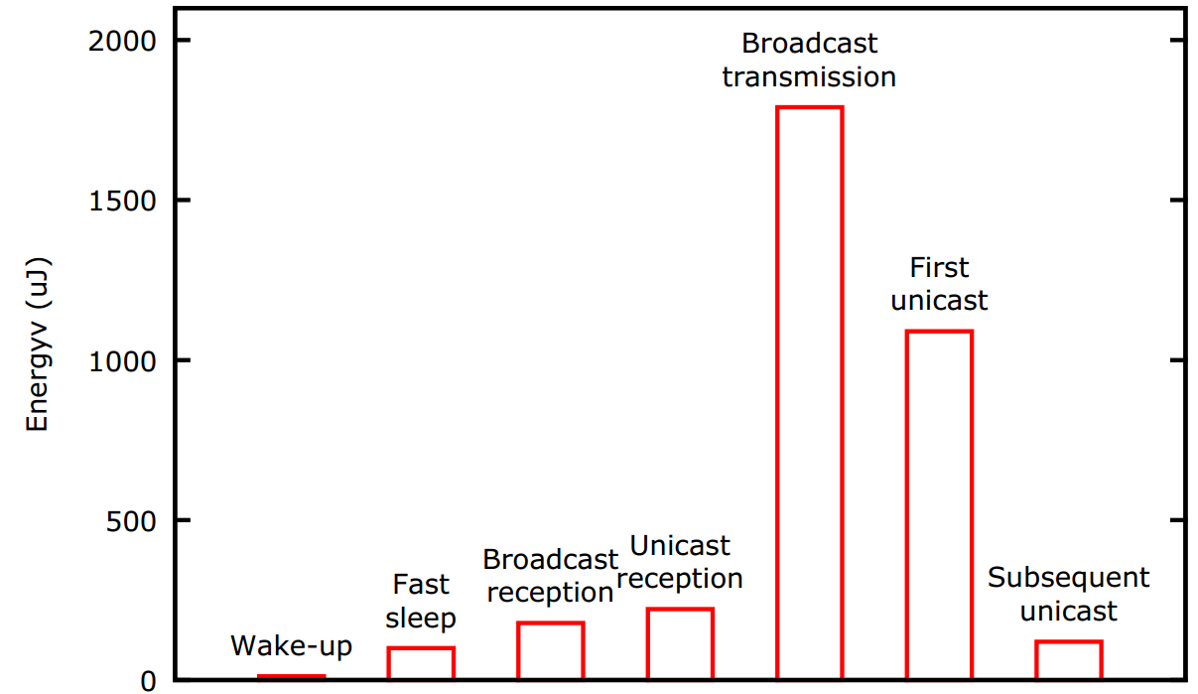
ContikiMAC
http://dunkels.com/adam/dunkels11contikimac.pdf

Slide 97
Contiki
2001
2003-2004
2007
uIP
Contiki,
Protothreads
COOJA,
Power Profiling
2008
2009-2010
2011
SICSLoWPAN
Many more
Platforms
ContikiRPL
ContikiMAC
2012
Connect to the Cloud: Thingsquare

Slide 98
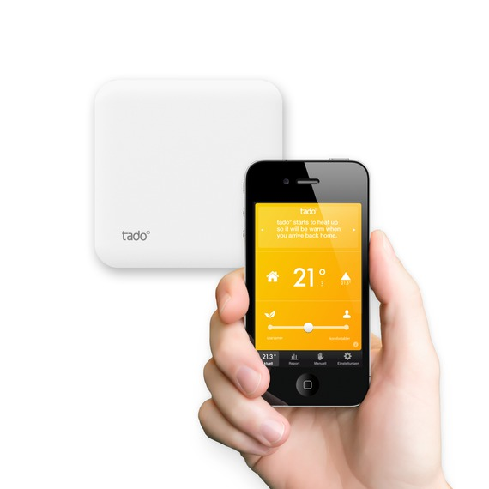
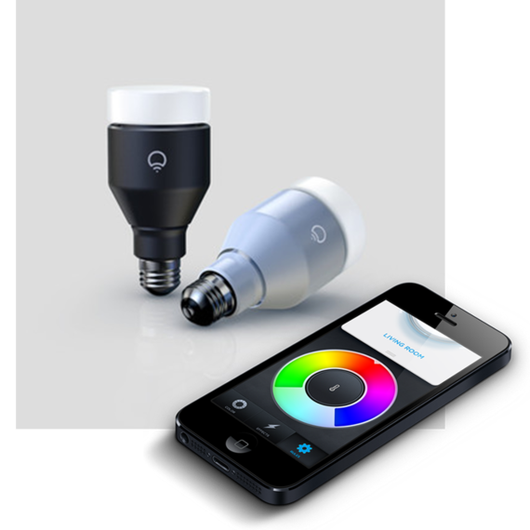
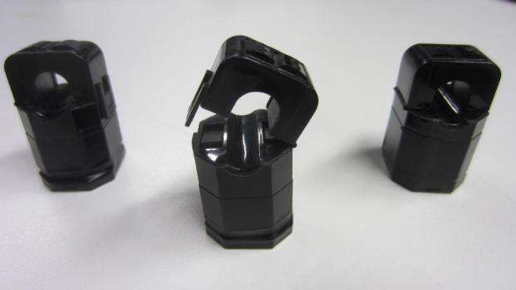
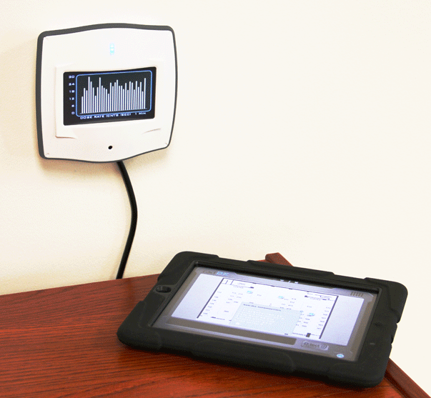

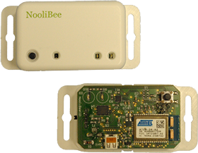
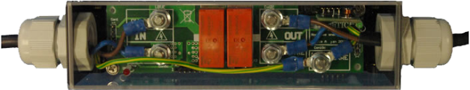
Contiki-based Projects
Redwire self-powered sensor
www.tado.com
www.lifx.co
http://www.redwirellc.com/
http://www.dtectsystems.com
http://www.noolitic.com/

Slide 99
Contiki
2001
2003-2004
2007
uIP
Contiki,
Protothreads
COOJA,
Power Profiling
2008
2009-2010
2011
SICSLoWPAN
Many more
Platforms
ContikiRPL
ContikiMAC
2012
2013
6LBR
Connect to the Cloud: Thingsquare

Slide 100

Ongoing
Activities
@

Slide 101
6LBR: A Deployment-Ready Border Router for Internet of Things
Internet
WSN
CETIC (Laurent Deru, Sébastien Dawans)
UMons (Maxime Denis, Bruno Quoitin)

Slide 102
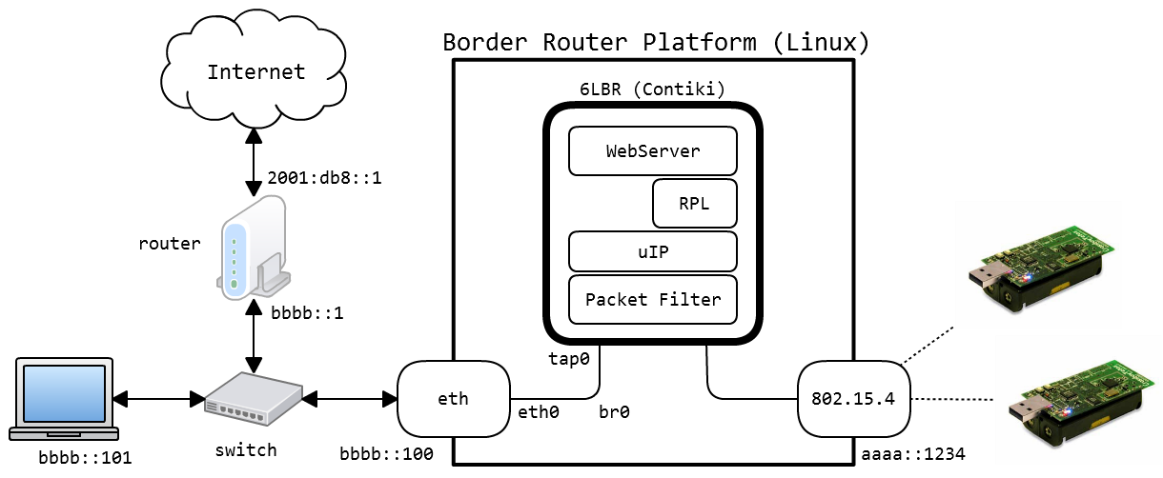
6LBR Overview
More info: https://github.com/cetic/6lbr/wiki/6LBR-Modes
Notes:
sd

Slide 103
6LBR Features
Today
Seamless integration of IPv6 and RPL
Run smoothly on low-cost hardware
Multi-BR (reliability, traffic balancing)
Highly modular regression testing framework
Ongoing
Multiple RPL Instances
Expand user base
Real-World Feedback

Slide 104
6LBR Demo

Slide 105
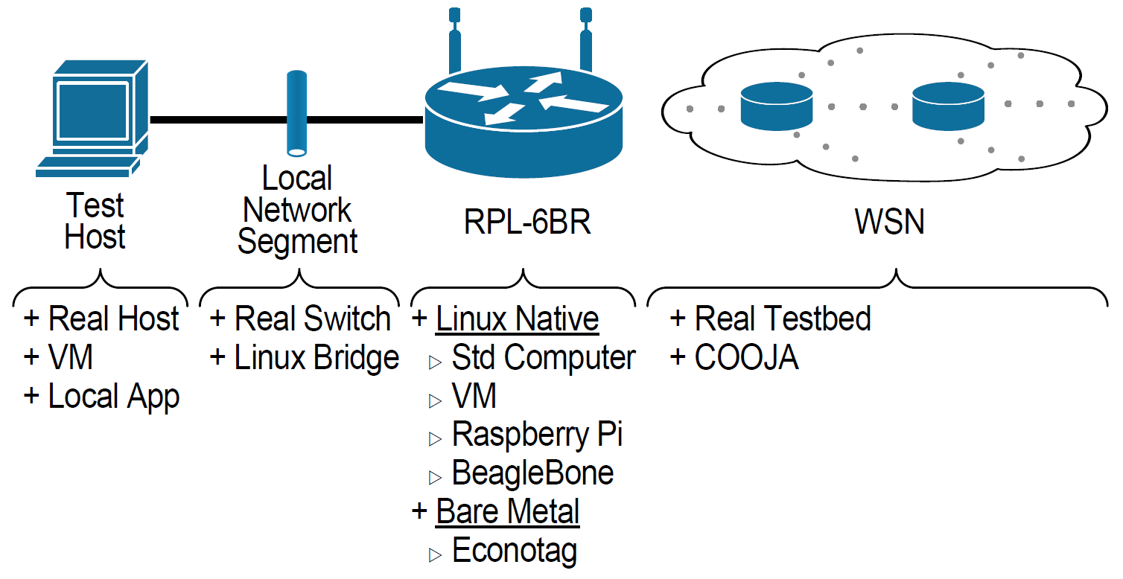
6LBR Test Framework
http://inl.info.ucl.ac.be/system/files/deru13redundant.pdf

Slide 106
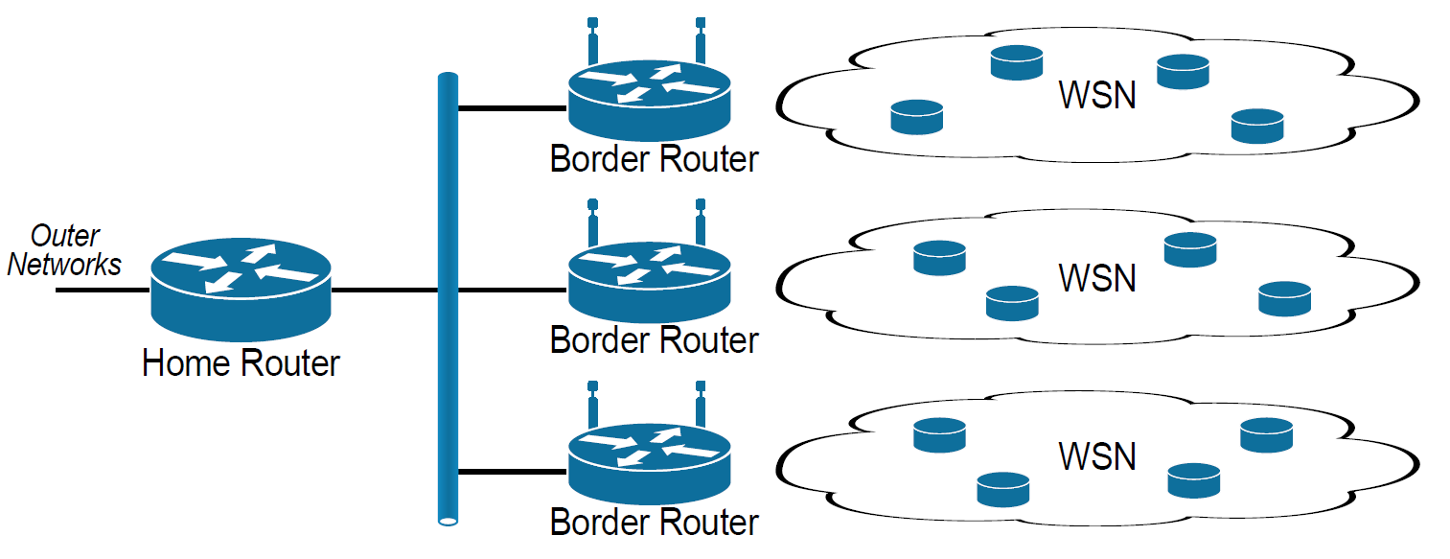
Multiple Border Routers
Spatial Diversity, Redundancy…

Slide 107
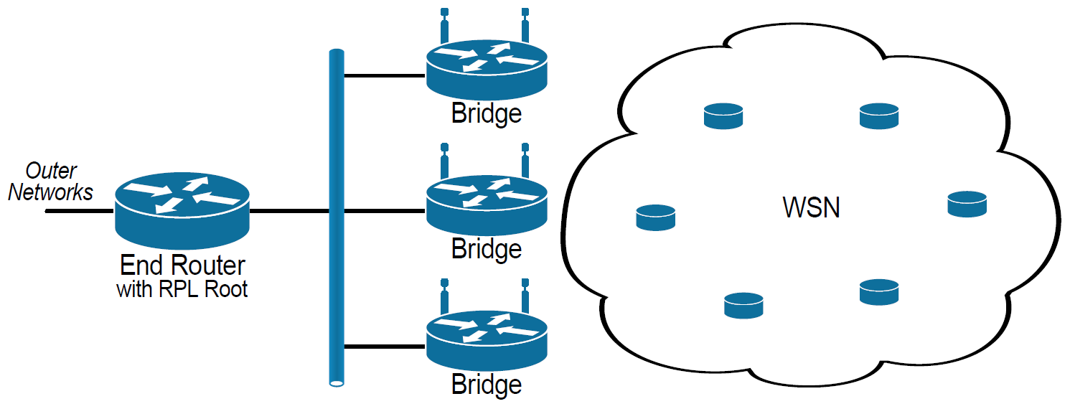
Multiple Border Routers
Aggregate the WSN with external RPL Root

Slide 108
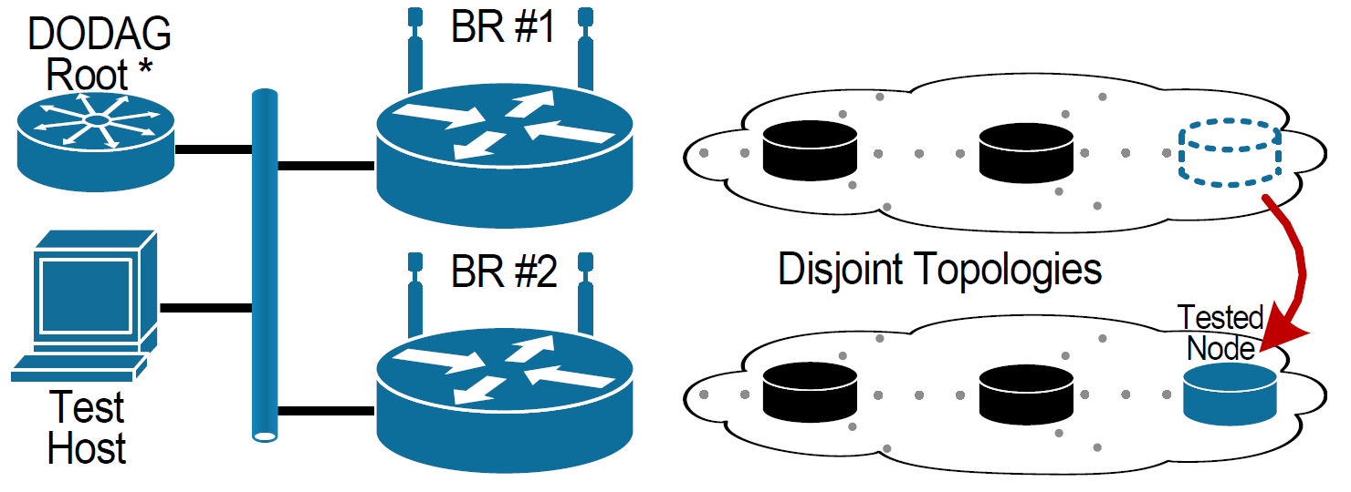
Node Mobility

Slide 109
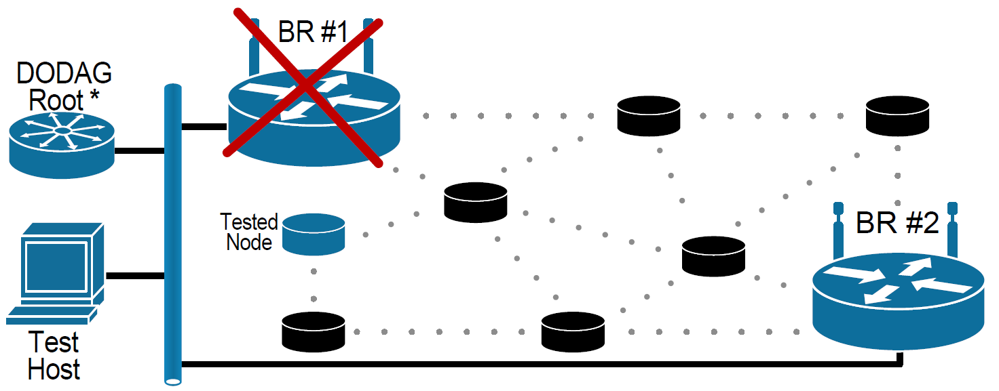
Border Router Redundancy

Slide 110
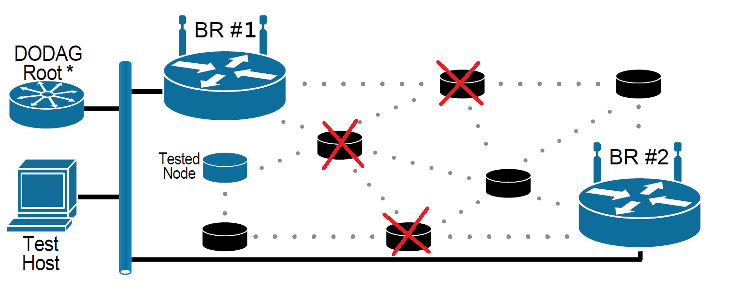
Network Partitioning

Slide 111
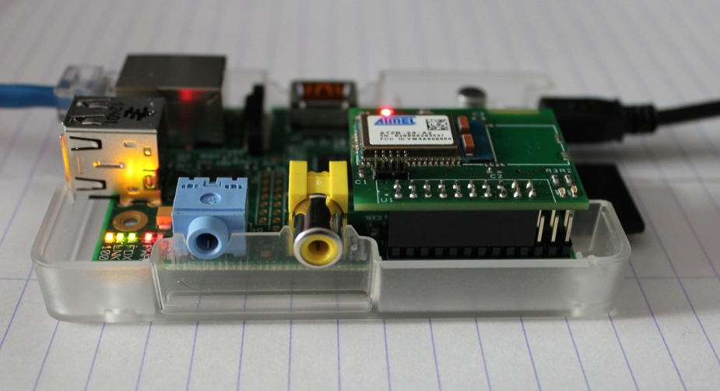
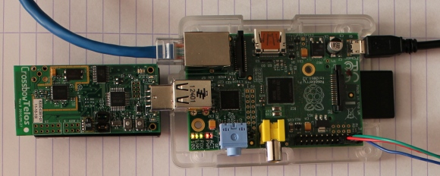
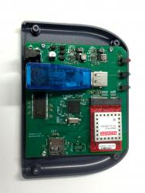
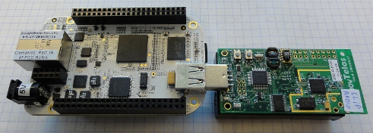
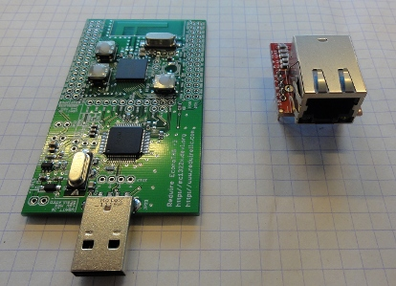
6LBR Platforms
RPi + Nooliberry
RPi + any « Contiki Mote »
BR12
BeagleBone
Redwire, LLC
Econotag

Slide 112
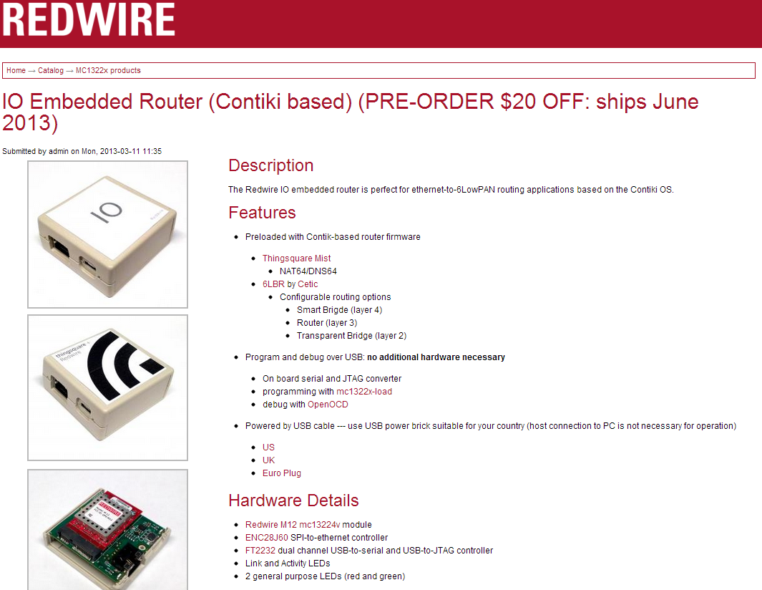

Slide 113
Ongoing
Activities
@
IoT Testbed

Slide 114
CETIC Testbed Deployment
25 nodes of 3 different models & border routers
6LBRs
Notes:
mo & sd

Slide 115
CETIC Testbed Overview
CETIC WSN Testbed
Backend
Web Frontend
Control Jobs
Server
Administration
Academic Experiments
IoT Products Prototyping
SN1
…
SNn
Debug Info
Hub
Hub
Hub
USB Backbone

Slide 116

From Simulations to Reality
Simulation
+ control
+ reproductibility
- poor channel models
- Limited hw platforms
Real World
Deployment
- huge debugging issues
- physical access difficult
- many unexpected problems

Slide 117
From Simulations to Reality
Testbed
Simulation
+ many platforms
+ near-real channel
- costly
- harder to debug
+ control
+ reproductibility
- poor channel models
- Limited hw platforms
Real World
Deployment
- huge debugging issues
- physical access difficult
- many unexpected problems

Slide 118
From Simulations to Reality
Testbed
Simulation
+ many platforms
+ near-real channel
+ trace at every mote
- costly
+ control
+ reproductibility
- poor channel models
- Limited hw platforms
Real World
Deployment
- huge debugging issues
- physical access difficult
- many unexpected problems
Passive Sniffing
+ non-intrusive debugging
- partial information
- sniffer deployment

Slide 119

Ongoing
Activities
@
Foren6
IoT Testbed

Slide 120
Foren6: Passive IoT Diagnostics

Slide 121

Still Alive? IoThanks!
sebastien.dawans@cetic.be
laurent.deru@cetic.be

